Slide 1
MCCP6020 Advanced English for Academic Purposes
Session 7
Drawing Conclusions and Highlighting Significance of the Research
Giving an Academic Presentation (Poster Presentation Skills)

Slide 2
Learning Outcomes
By the end of this session, students should be able to:
write the Conclusion section with appropriate organizational structure and linguistic resources
highlight the significance of the research using appropriate expressions and rhetorical strategies
engage their audience through telling compelling research story, maintaining eye contact, and providing thoughtful responses during poster presentations
design visually appealing posters that enhance understanding, utilizing principles of layout, color, and typography

Slide 3
Writing the Conclusion Section
The conclusion section of a research paper is a crucial component that ties together the main findings and implications of your work. It serves as the final opportunity to reinforce your research's significance, offering a concise summary of key insights and their relevance to the field. A well-crafted conclusion not only synthesizes the main arguments but also highlights the broader impact of your research, suggesting avenues for future study and inviting further exploration of the topic. Mastering this section enhances the overall coherence of your paper and leaves a lasting impression on your readers.

Slide 4
Warm-up Task
Find a partner and discuss the following questions:
1. What are the functions of the Conclusion section of a thesis and a journal article?
A backward-looking function:
• Stating the contribution of the research (How has it ‘filled’ the research space identified earlier in the thesis/research paper?)
• Identifying the limitations of the research (What gaps have you ‘left’ in the research space? What is it that we still don’t know?)
A forward-looking function:
• Making suggestions for further research (How could other researchers build on what you have done?)

Slide 5
2. What should be avoided in the Conclusion section of a thesis and a journal article?
• Straight repetition of statements already made
• Bringing new information not touched on
• Being too self-congratulatory in the contribution
• Being too self-critical in the limitations

Slide 6
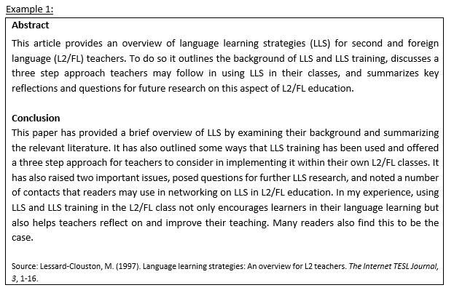
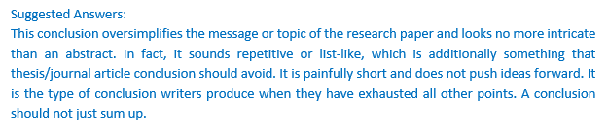
Task 1
Read and comment on the following two examples of the Conclusion section. Are they effective? Why/why not?
The abstracts below give you some ideas about the research.

Slide 7
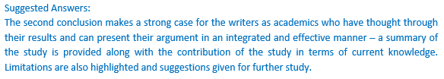

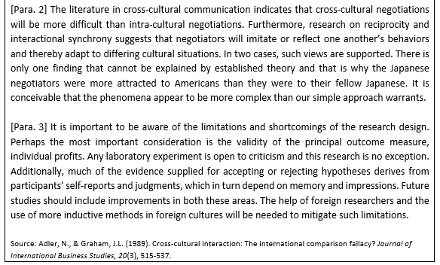

Slide 8
Task 2
Rhetorical Moves in the Conclusion Section
The Discussion/Conclusion sections model proposed by Hopkins and Dudley-Evans (1988)¹ , Kanoksilapatham (2015)² and Swales and Feak (1994)³ consists of seven moves:
Move 1 | Re-stating the focus of the study (purposes, research questions and hypotheses restated) (Obligatory)
Move 2 | Stating selected findings (Obligatory)
Move 3 | Making claims or generalizations (Conventional)
Move 4 | Recommendation for practical application (Optional)
Move 5 | Exemplifying (Optional)
Move 6 | Limitations of the study (Conventional)
Move 7 | Further research suggested (Conventional)
* Note that not all the seven moves are obligatory.
¹Dudley-Evans, T. (1994). Genre analysis; an approach to text analysis for ESP. In M. Coulthard (Ed.). Advances in written text analysis (pp.220-228). London: Routledge.
² Kanoksilapatham, B. (2015). Distinguishing textual features characterising structural variation in research articles across three engineering sub-discipline corpora. English for Specific Purposes, 37, 74-86.
³ Swales, J., & Feak, C. (1994). Academic writing for graduate students. A course for non-native speakers of English. Ann Arbor: University of Michigan Press.

Slide 9
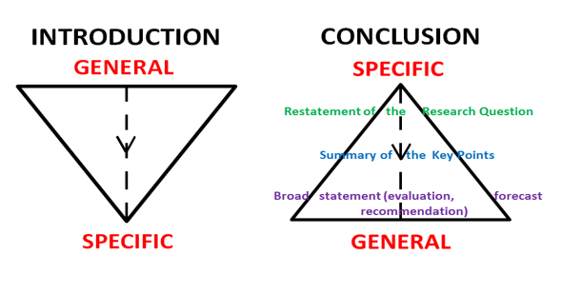
The introduction to a thesis or a journal article places the research questions in context by moving from a wide to a specific focus. This specificity is retained throughout the paper until the conclusion. It is at this point that the content moves to a broader context again. See the diagram below.

Slide 10
Task 2
Read the Conclusion section of 2-3 journal articles of your field. Can you identify the moves stated in Task 2? Write down the moves in the table below. Compare i). the number and ii). the sequence of moves in the Conclusion section of the journal articles. Are they similar or different?
Share your findings with a partner
 | Journal Article 1 | Journal Article 2 | Journal Article 3
Move 1
Move 2
Move 3
Move 4
Move 5
Move 6
Move 7

Slide 11
Task 3
Language Features of the Conclusion Section
Read the following example of the Conclusion section taken from a journal article in the field of Clinical Psychology. The abstract gives you some ideas about the research. Analyze the language features (e.g. tense, sentence structure, voice, and hedging language) of the Conclusion Section. Report your findings to a partner.

Slide 12
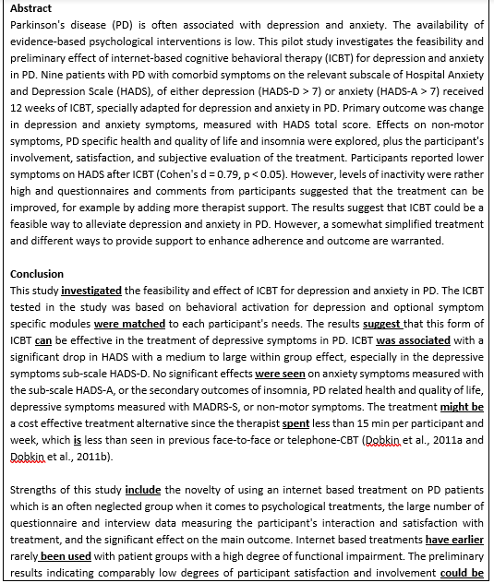
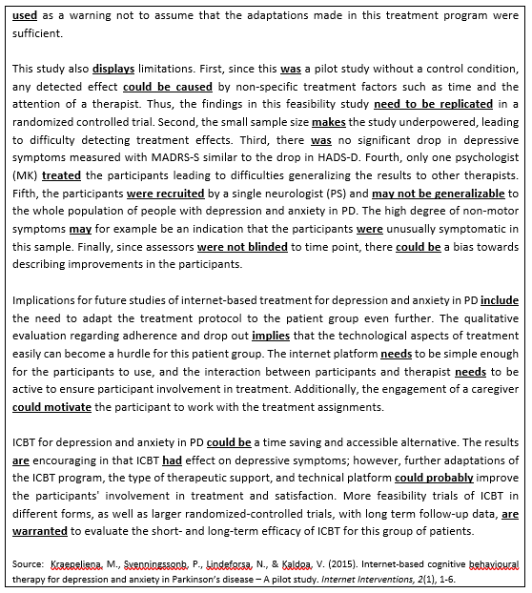

Slide 13
Suggested Answers:
Feature 1: Use the simple past tense to discuss your major findings
e.g. ICBT was associated with a significant drop in HADS with a medium to large within group effect, especially in the depressive symptoms sub-scale HADS-D. No significant effects were seen on anxiety symptoms measured with the sub-scale HADS-A, …
Feature 2: Use the simple present tense to discuss their possible implications
e.g. Implications for future studies of internet-based treatment for depression and anxiety in PD include the need to adapt the treatment protocol to the patient group even further. The qualitative evaluation regarding adherence and drop out implies that the technological aspects of treatment easily can become a hurdle for this patient group. The internet platform needs to be simple enough for the participants to use, and the interaction between participants and therapist needs to be active to ensure participant involvement in treatment.

Slide 14
Feature 3: Use the passive voice to emphasize the actions rather than the subject
e.g. The ICBT tested in the study was based on behavioral activation for depression and optional symptom specific modules were matched to each participant's needs.
e.g. Thus, the findings in this feasibility study need to be replicated in a randomized controlled trial.
e.g. Fifth, the participants were recruited by a single neurologist (PS)…
Feature 4: Use hedging language to tone down the limitations and express your degree of uncertainty
e.g. The treatment might be a cost- effective treatment alternative…
e.g. First, since this was a pilot study without a control condition, any detected effect could be caused by non-specific treatment factors such as time and the attention of a therapist.
e.g. Fifth, the participants were recruited by a single neurologist (PS) and may not be generalizable to the whole population of people with depression and anxiety in PD.
e.g. ……; however, further adaptations of the ICBT program, the type of therapeutic support, and technical platform could probably improve the participants' involvement in treatment and satisfaction.

Slide 15
Task 4
Highlighting the Significance of the Research
One of the important moves in the Conclusion section is to highlight the significance of the research. There are a number of ways to do this:
You can highlight the contributions of your research (new knowledge discovered) which may be methodological, theoretical, pedagogical contributions or potential applications of the new findings.
If your research is pioneering in the field, you should emphasize the novelty in the conclusion and suggest how future research can build upon the findings of your study.
If your research builds on the findings of the previous studies, you can highlight how your research findings are similar or different from the previous research (e.g. whether your research findings confirm/support or refute the findings of the previous studies; what additional evidence is provided?)

Slide 16
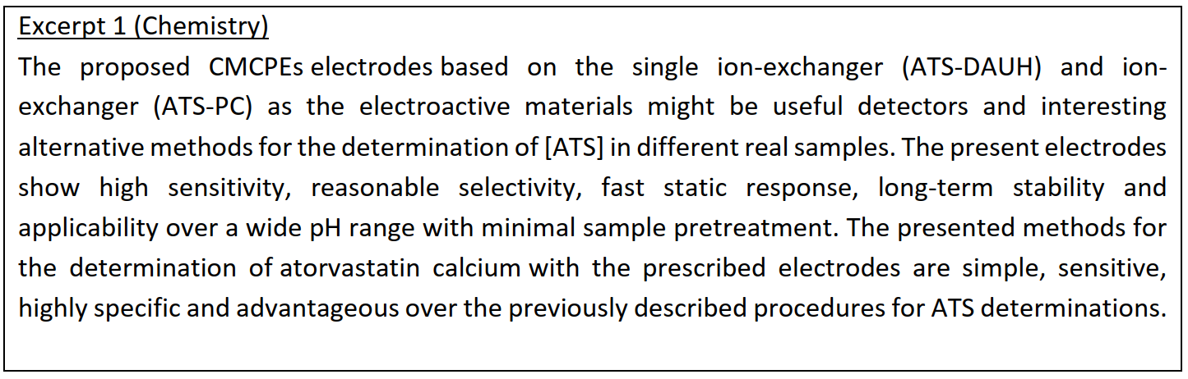
Read the following excerpts taken from the Conclusion sections of three different research articles in the fields of Chemistry, Visual Arts and Computer Science. How did the author(s) highlight the significance of their research? Underline the expressions that were used to emphasize the significance of the research.
Highlighting the methodological contribution

Slide 17
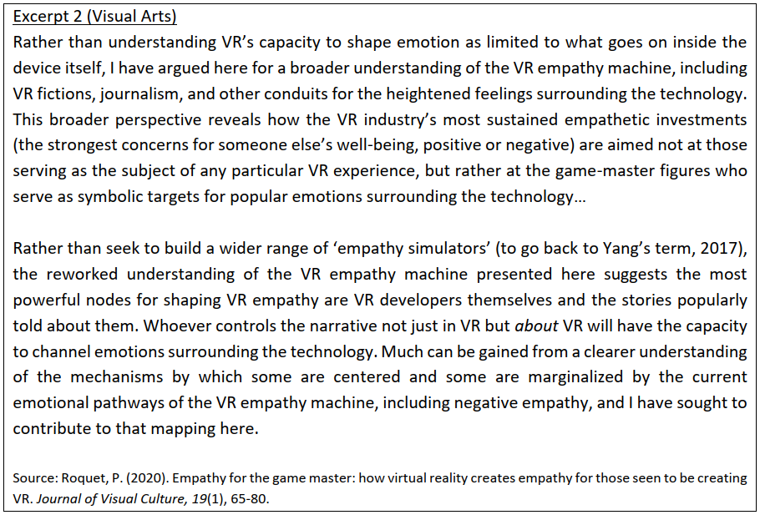
Highlighting the theoretical contribution

Slide 18
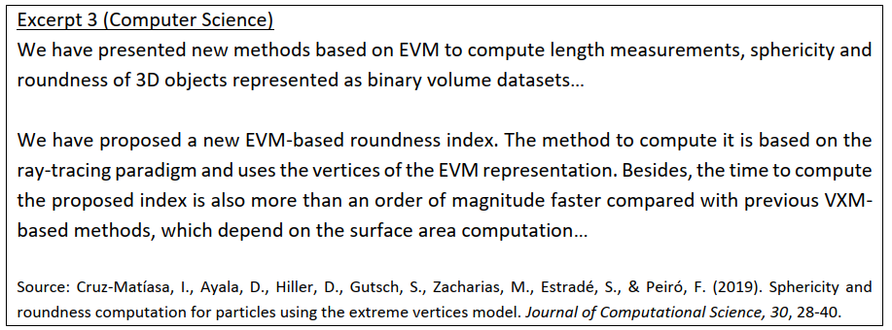
Highlighting the methodological contribution
Please visit the Academic Phrasebank to check for more expressions for highlighting the significance of the research: http://www.phrasebank.manchester.ac.uk/writing-conclusions/

Slide 19

Significance of Your Research
What is the significance of your research? What would be the contributions of your research (new knowledge discovered)?
Tell ChatGPT briefly what your research is about. Then, ask for suggestions regarding how to highlight the significance of your research in the Conclusion section. Share your ideas with the class.

Slide 20
Task 5
Use the expressions from the Academic Phrasebank (see below) and write 2-3 sentences to highlight the significance of your study.
The findings will be of interest to … This study has provided a deeper insight into … The findings reported here shed new light on … These results add to the rapidly expanding field of … The contribution of this study has been to confirm … This project is the first comprehensive investigation of … The insights gained from this study may be of assistance to … The analysis of X undertaken here, has extended our knowledge of … The empirical findings in this study provide a new understanding of … This approach will prove useful in expanding our understanding of how … | This new understanding should help to improve predictions of the impact of … The methods used for this X may be applied to other Xs elsewhere in the world. The X that we have identified therefore assists in our understanding of the role of … This is the first study of substantial duration which examines associations between … The findings from this study make several contributions to the current literature. First,… These findings contribute in several ways to our understanding of X and provide a basis for … This study has been one of the first attempts to thoroughly examine … This study has confirmed the findings of XXX which found that…

Slide 21
Write 2-3 sentences which highlight the significance of your research:

Slide 22

Poster Presentation
Poster presentations are an integral part of academic communication, allowing researchers to visually convey their work in a concise and engaging manner. This format combines elements of graphic design and verbal presentation, enabling you to showcase your research findings to a diverse audience. A well-designed poster captures attention and facilitates discussion, making it an effective tool for networking and receiving feedback. In the following tasks, you will learn how to create compelling posters that not only highlight your research but also engage viewers and foster meaningful interactions.

Slide 23
Task 6
Read the following examples of posters. Discuss in small groups.
What information is typically included in a poster for presentation at international conferences?
Which poster do you think presents the key research information most effectively? Why?
What are some design principles that should be taken into considerations when preparing a poster for presentation at international conferences?
Title, author(s) and affiliation(s), introduction/background, objectives/aims, methods/methodology, results/findings, discussion/interpretation, conclusion, references, acknowledgements, contact information, visuals and layout
Clarity and simplicity, logical layout, readable fonts, effective use of colour, visual hierarchy (emphasize important elements using size, boldness, or color to draw attention), high quality visuals, consistent style, adequate white space, balanced content, accessibility (ensure the content is accessible to a diverse international audience)

Slide 24
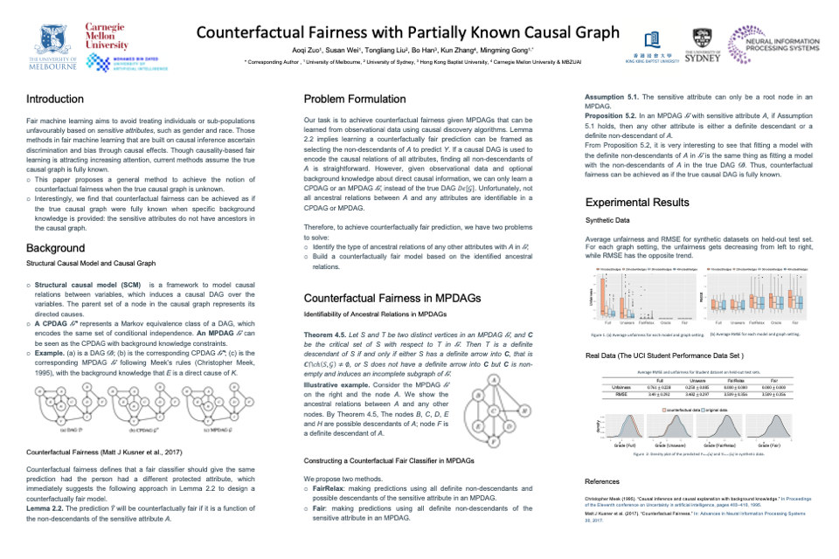
Example 1 NeurIPS Poster Counterfactual Fairness with Partially Known Causal Graph

Slide 25

Example 2: "What Do We Think About Birth Order?" by Jessica Garcia

Slide 26
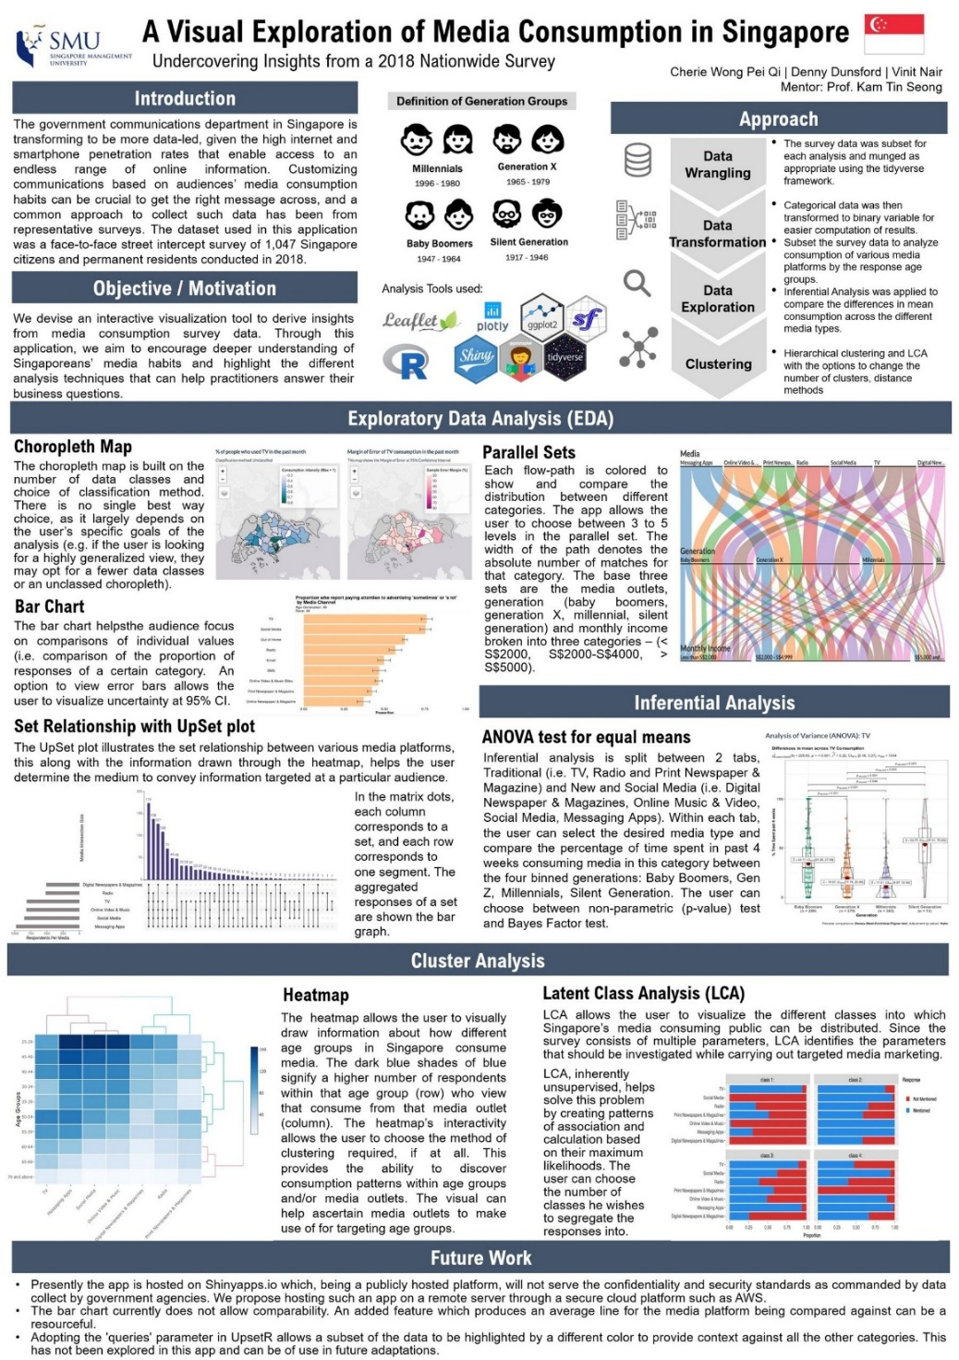
Example 3: Group02 poster - ISSS608-Visual Analytics and Applications

Slide 27

Example 4: Poster Examples - Designing Research Posters - Research Guides at University of Colorado Colorado Springs

Slide 28
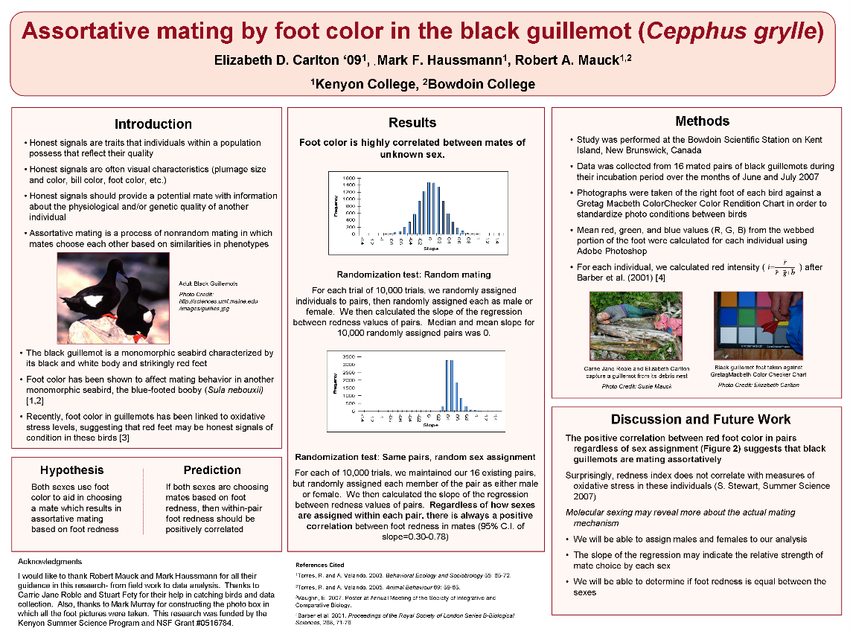
Example 5: Poster Examples - Designing Research Posters - Research Guides at University of Colorado Colorado Springs

Slide 29
Task 7
Watch this video Giving an Effective Poster Presentation about giving poster presentations at international conferences. Answer the following questions:
What are the Dos and Don’ts in a poster presentation?
How to decide what information to put in a poster?
What should you do if you do not know how to answer the questions from the audience?
Don’t read your poster.
Use your poster as a tool
Be prepared! Expect questions.
Presenter engaged with viewer.
Don’t put everything on your poster.
Don’t know something? Just admit it. Don’t make things up!
Consider what are the main things that you would like to convey to the audience
Provide your contact details and suggest getting back to the audience/viewer later.

Slide 30
Task 8
Data visualization is the graphical representation of information and data. It is a commonly used technique for presenting research results in research writing and presentations. By using data visualization tools such as charts, tables, graphs, and maps, it will be easier for both technical and non-technical audiences to see and understand trends, outliers, and patterns in data.
Steps for explaining data visualization in an academic presentation:
Tell the audience what the visual is about
Guide the audience to read and understand the visual in a particular sequence according to your intended purpose
Highlight the significant aspects which are worth noting when interpreting the data
Explain the significance/meaning of the data (What do the data show?)

Slide 31
Task 8
Useful phrases for explaining data visualization in an academic presentation:
Please refer to the next page for an example of good data visualization and the explanation of the visual.
Tell the audience what the visual is about | Guide the audience to read and understand the visual in a particular sequence according to your intended purpose | Highlight the significant aspects which are worth noting when interpreting the data | Explain the significance/meaning of the data
Let’s look at this bar graph which shows… Let’s turn to this diagram which presents… If you look at this line chart, you will notice… To illustrate my point, let’s look at some charts… Here we can see… | The vertical axis shows… The horizontal axis represents… This curve illustrates… The solid line shows… The shaded area represents… This colored segment is for… The table below… Above the table, you can see… | It is worth noting that there was a rapid increase in… I’d like to draw your attention to… As you can see, there was a sudden drop in… It’s interesting that… Take a look at this part of the diagram… | XXX clearly shows…, meaning that… The data show that… Overall, the data show a strong positive correlation between… Overall, the data provide evidence to support the argument that…

Slide 32
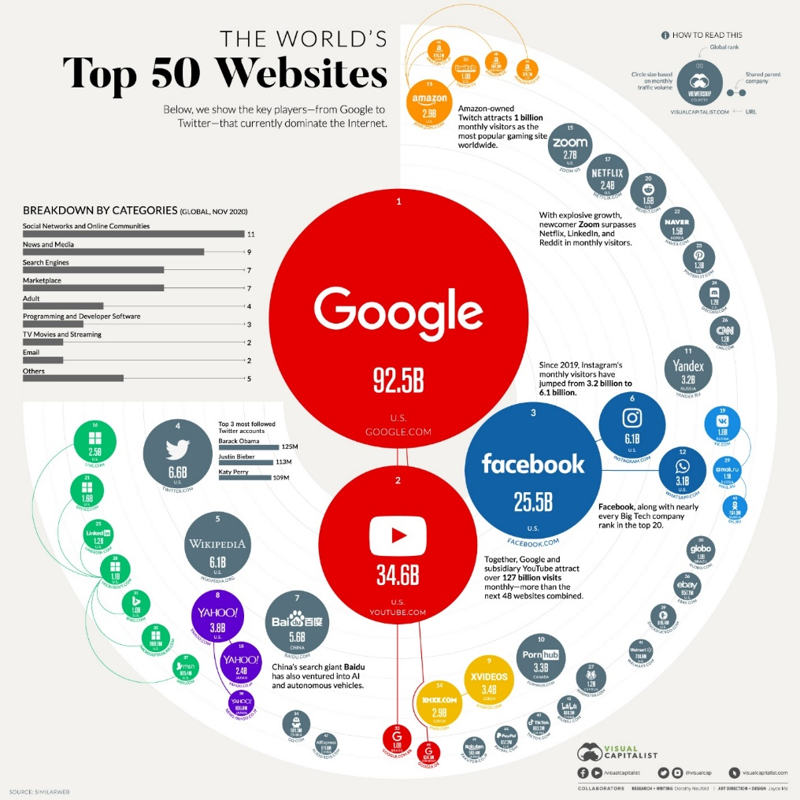
Task 8
An example showing how the visual can be explained to the audience in a presentation:
[Step 1] Let’s turn to this diagram which shows the world’s most popular websites as of November 2020. [Step 2] The bar chart at the top left shows a breakdown of websites by categories. Here you can see the global rank of the website at the top of the circle, and the circle size is based on monthly traffic volume. [Step 3] It is clear that Google, YouTube and Facebook are the top three most visited websites. What’s more, as the pandemic transformed the way we work, learn, communicate and shop, a majority of these activities migrated online. For example, it is not surprising that Zoom has grown explosively, with its number of monthly visitors surpassing Netflix, LinkedIn and Reddit. [Step 4] Overall, the data provide evidence to support the argument that social media and news have become part of everyday life of a majority of people worldwide. The data presented gives insight into the industries in which these sites operate and the traffic they attract.

Slide 33
Task 8
Practice
Refer to a journal article in your discipline which includes data visualization. Imagine that you need to explain one of the visuals in the journal article to a group of both technical and non-technical audience in an academic presentation.
How would you start your explanation?
How would you guide your audience to understand the data?
What information will you highlight to the audience?
How would you explain the significance/meaning of the data?
Follow the steps of explaining data visualization introduced above. Practise explaining the visual to a partner.

Slide 34
OPTIONAL TASK - Supplementary Information on Visual Aids for Academic Presentations (Paper Presentations and Poster Presentations)
Effective use of visual aids can enhance your presentations. They can increase the audience’s understanding of your topic, make an impact and engage the audience. Visual aids are chosen depending on their purpose. In an academic presentation, power point slides are always used. The following tasks give you some suggestions about the choice of colouring and typographical features in academic presentations.

Slide 35
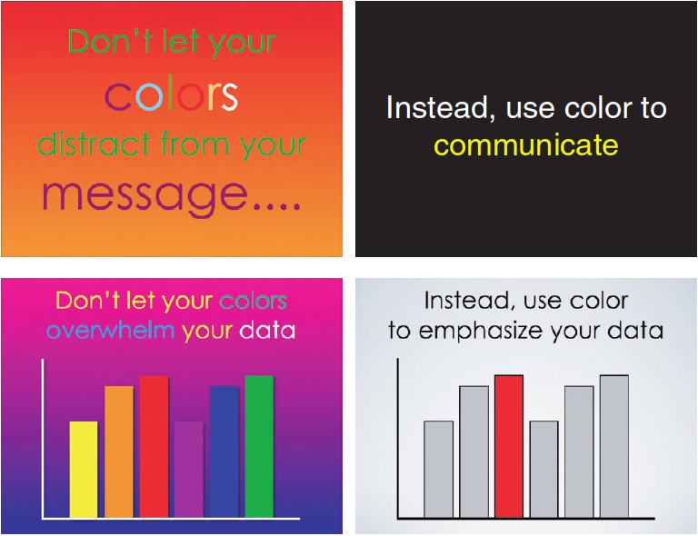
1. Have a look at the four example PPT slides below. Which two slides do you find easier to read? Why?

Slide 36
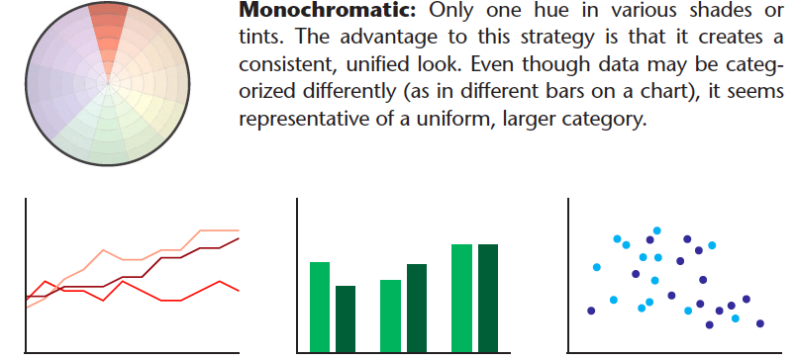
There are three effective ways of using multiple colours:
1.

Slide 37
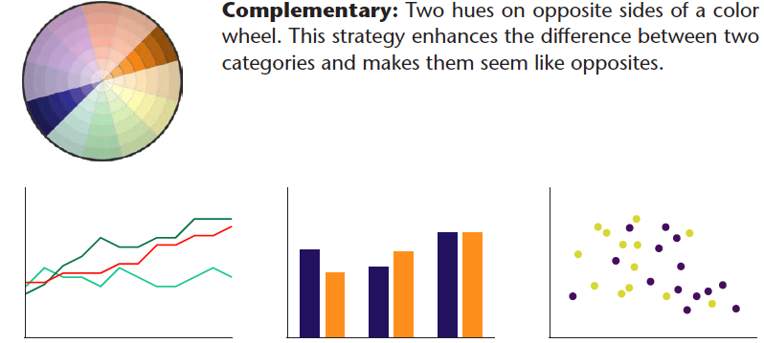
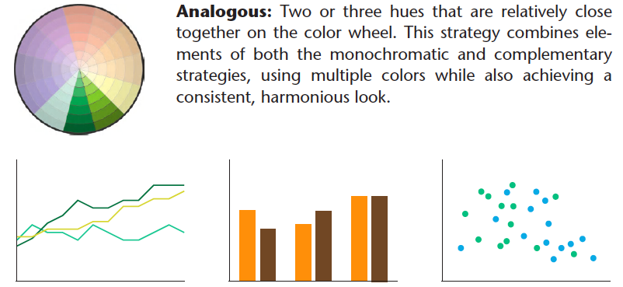
2.
3.

Slide 38
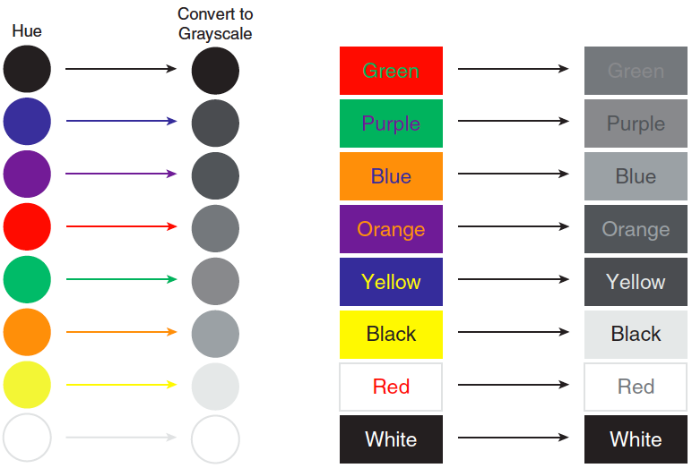
Choosing background colours:
The colours you choose for your foreground and background should be as far apart in value as possible to maximize visibility.
To test various foreground/ background combinations, convert your colours to grayscale. The more your two colours approach the values of black and white, the greater the contrast and the clearer your message.

Slide 39
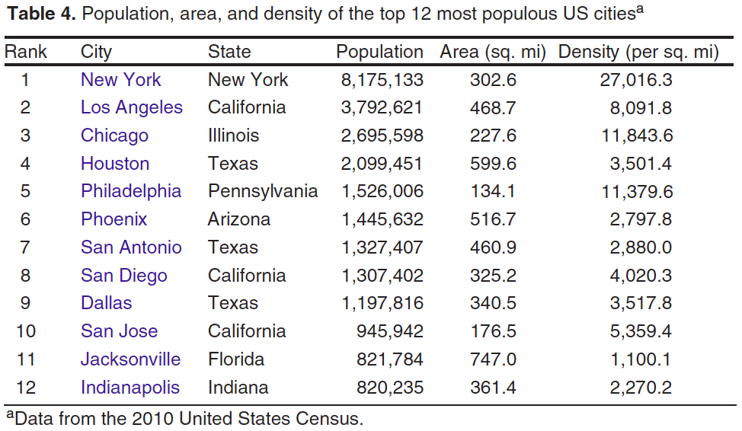
Using colours to highlight:
When there is too much information in a slide and you would like to draw the audience attention to certain points, you can use colours to highlight those you will talk about.

Slide 40
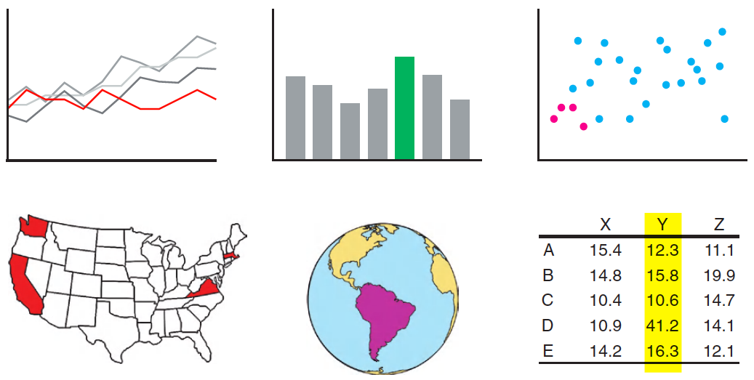
Which colour in each diagram do you see immediately?

Slide 41
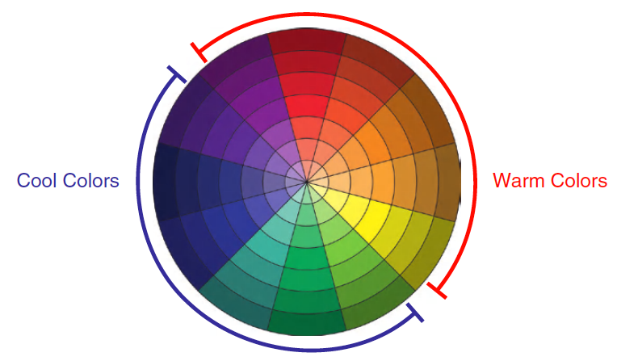
When multiple colours are present, the audience will tend to see warm colours first.

Slide 42
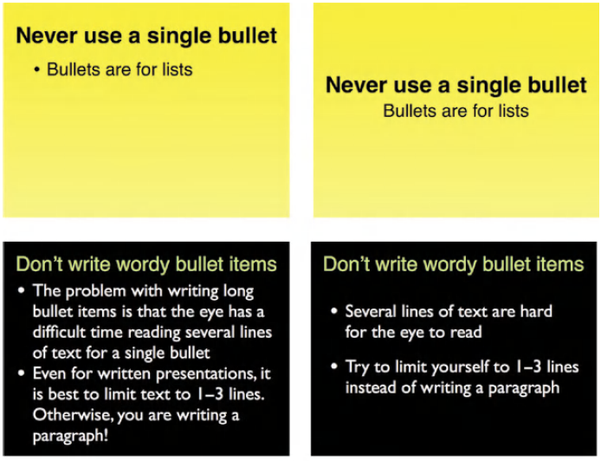
1. Which slides are easier to read, those on the left or right?
Rule 1: Never use a single bullet
Rule 2: Don’t write wordy bullet items

Slide 43
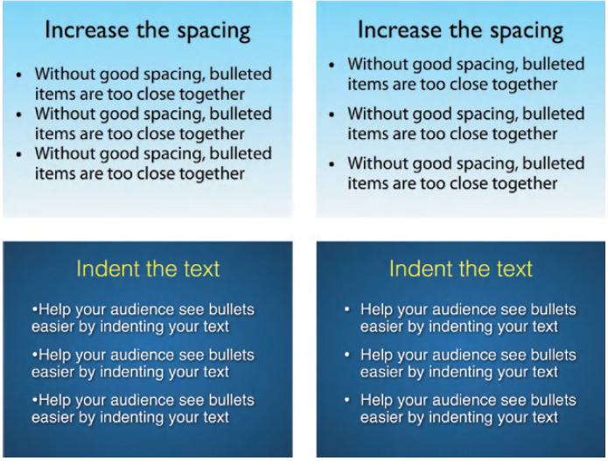
2. Which slides are easier to read, those on the left or right?
Rule 3: Increase the spacing
Rule 4: Indent the text

Slide 44
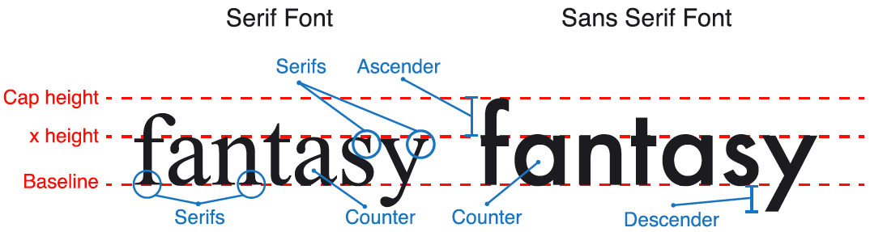

3. Which font do you prefer, Serif or Sans Serif? Why?
Sans serif fonts are usually perceived as simple or pure. They are easier to see from a distance. They are best for slide and poster presentations.

Slide 45
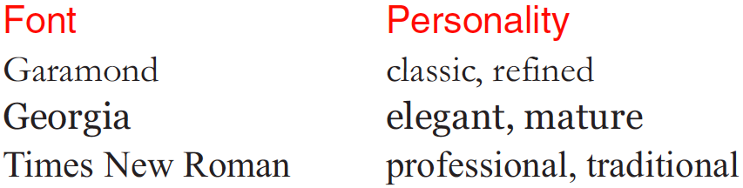
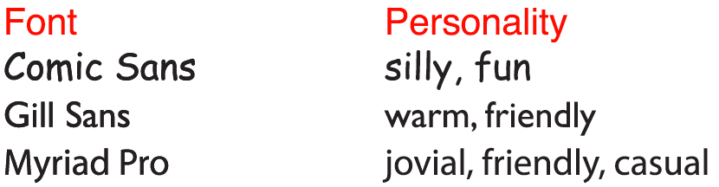
ii. Serif fonts convey tone and personality and are good for smaller character sizes (10–14 pts) in multiple lines of type.
iii. Some sans serif fonts convey a bit more personality than others. They are more playful and can make a presentation seem less standard or routine.

Slide 46
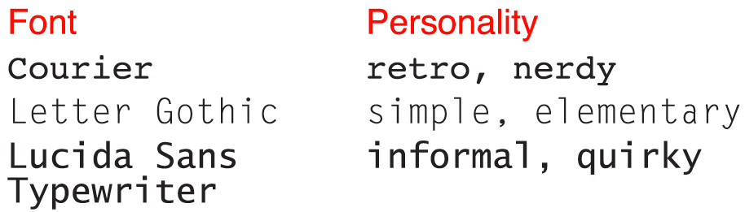
iv. Non-proportional (or “monospaced”) fonts are those with each character having the same width. They catch people’s attention easily and are best used in isolation, such as in title slides, flyers.

Slide 47
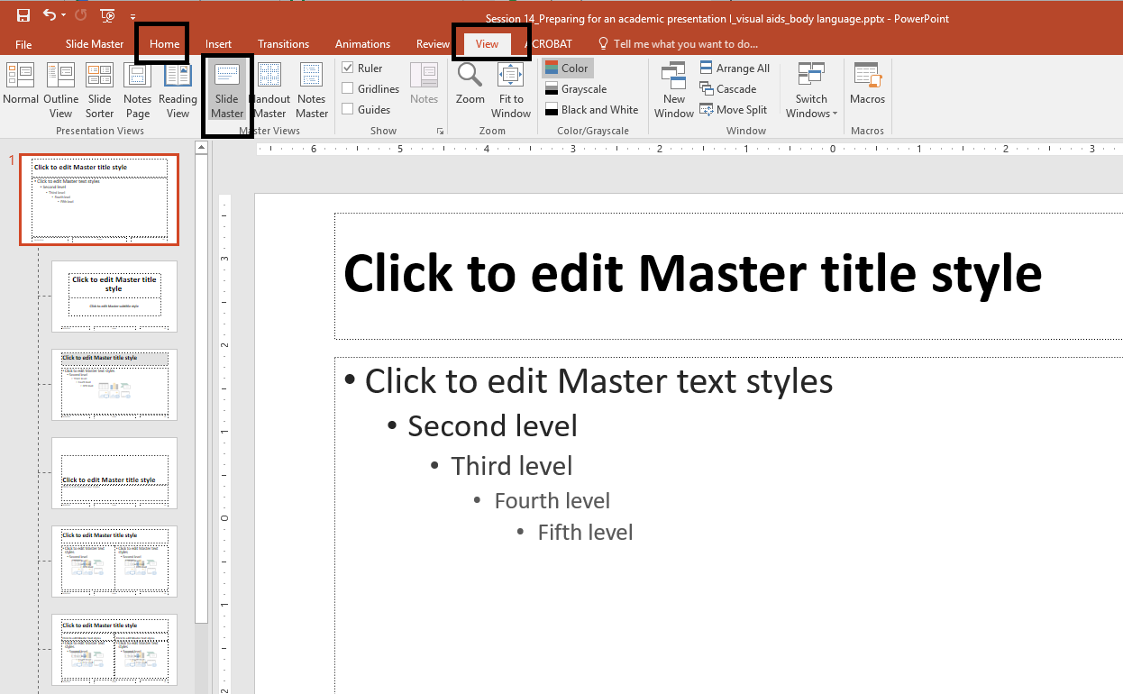
Formatting Fonts: Using the Slide Master
Click on “View”
Then click on “Slide Master”
Now click on “Home” to change the font format

Slide 48
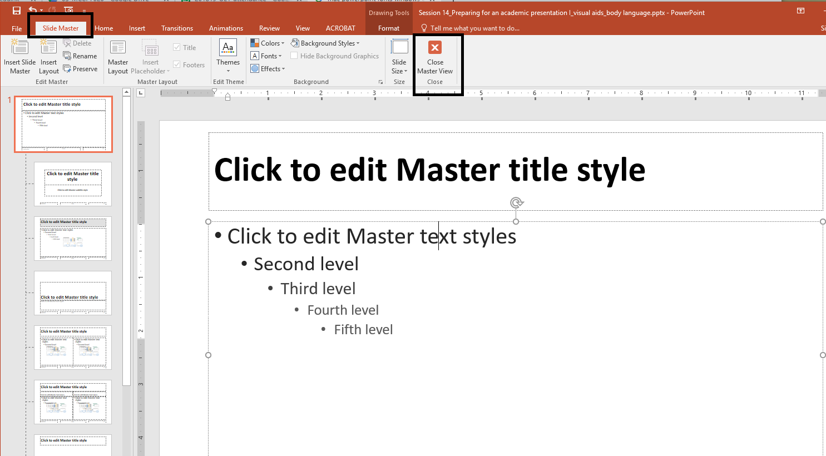
After you have finished formatting the fonts, click on “Slide Master” and then click “Close Master View” to go back to the slides.

Slide 49
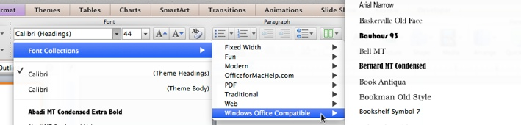
Formatting Consistency across Platforms
If you use MS PowerPoint on Mac, select Windows-compatible fonts:
If possible, always check on the computer in the room where you are going to present before the presentation.

